Slide 1
Deep Generative Graph Models lecture-12 Course on Graph Neural Networks (Winter Term 20/21)
Christian Medeiros Adriano (christian.adriano@hpi.de) - “Chris”
Sona Ghahremani (sona.ghahremani@hpi.de )
Prof. Dr. Holger Giese (holger.giese@hpi.de)

Slide 2
Why do we need Graph Generation?
Generative Models give insights into the phenomena that produced the graphs and networks in the first place.
Simulations of graph/network phenomena
Extrapolation
Unobserved data
Missing data or Outliers (Anomaly detection)
What if questions
Sensitivity Analysis
Counterfactual thinking

Slide 3
Generative Models
Traditional Generative Models:
Gaussian mixture model (and other types of mixture model)
Hidden Markov model
Probabilistic context-free grammar
Bayesian network (e.g., Naive bayes, Autoregressive model)
Averaged one-dependence estimators
Latent Dirichlet allocation
Boltzmann machine (e.g., Restricted Boltzmann machine, Deep belief network)
Variational autoencoder
Generative adversarial network
Flow-based generative model
Energy based model
Deep Generative Models
Adversarial Networks
Generative Pre-trained Transformer 3 (GPT-3)
Variational Auto-Encoders [Van den Oord et al. 2017][Doersch 2016]
Notes:
Van Den Oord, A., & Vinyals, O. (2017). Neural discrete representation learning. In Advances in Neural Information Processing Systems (pp. 6306-6315).
Doersch, Carl. "Tutorial on variational autoencoders. arXiv 2016." arXiv preprint arXiv:1606.05908 (2016).

Slide 4
Quick recap – Where are we now?
Graph Metrics and Random Models
Graph Classification - Clustering
Graph Sampling - Random Walks
Graph Embeddings - Message Passing
PageRank
Graph Structure Learning
Graph Convolutional Networks
Graph Attention Networks
Graph Evolution Networks
Temporal Graph Networks
Graph Neural Differential Equations
Deep Graph Generative Models
Causal Inference on Graph Neural Networks
Network Effects, Cascading and Contagion
Outbreak Detection in Networks
Influence Maximization in Networks
Design concerns
Understand a phenomenon
Extract features
Stablish baselines
Preprocessing data
Description models
Predict an outcome
ML architecture and pipeline
Training models
Evaluation models
Prediction models
Effects of interventions
Risks of confounding
Causal structure
Intervention models
Notes:
[Wang & Tax 2016] Wang, Feng, and David MJ Tax. "Survey on the attention based RNN model and its applications in computer vision." arXiv preprint arXiv:1601.06823 (2016).
[Luong et al. 2015] Luong, Minh-Thang, Hieu Pham, and Christopher D. Manning. "Effective approaches to attention-based neural machine translation." arXiv preprint arXiv:1508.04025 (2015).
[Vaswani et al. 2017] Vaswani, A., Shazeer, N., Parmar, N., Uszkoreit, J., Jones, L., Gomez, A. N., ... & Polosukhin, I. (2017). Attention is all you need. Advances in neural information processing systems, 30, 5998-6008.
Bahdanau, Dzmitry, Kyunghyun Cho, and Yoshua Bengio. "Neural machine translation by jointly learning to align and translate." arXiv preprint arXiv:1409.0473 (2014).
Xu, Kelvin, et al. "Show, attend and tell: Neural image caption generation with visual attention." International conference on machine learning. 2015.
The research described in the paper Graph Convolutional Network (GCN), indicates that combining local graph structure and node-level features produces good performance on node classification tasks. However, the way GCN aggregates is structure-dependent, which can hurt its generalizability.
One workaround is to simply average over all neighbor node features as described in the research paper GraphSAGE. However, Graph Attention Network proposes a different type of aggregation. GAN uses weighting neighbor features with feature dependent and structure-free normalization, in the style of attention.

Slide 5
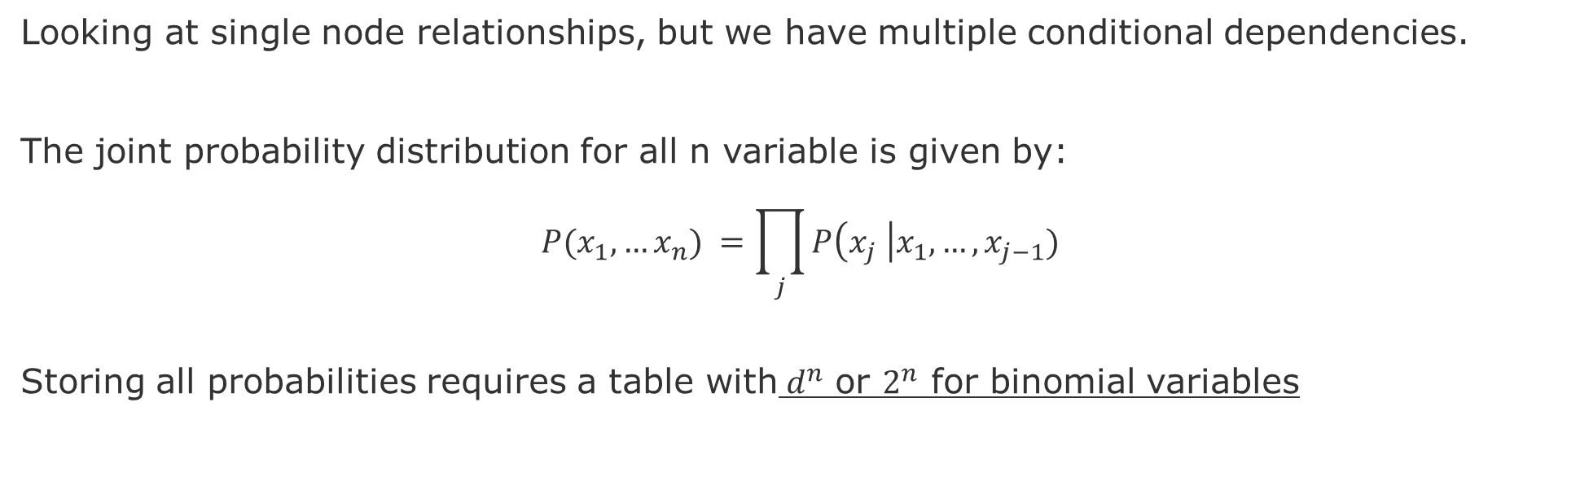
Methodological problem- Context
Looking at single node relationships, but we have multiple conditional dependencies.
The joint probability distribution for all n variable is given by:
$$P(x_{1},…x_{n}) =\prod_{j}{P\left(x_{j} \right|x_{1},…,x_{j−1})}$$
Storing all probabilities requires a table with${ d}^{n}$ or $2^{n}$ for binomial variables
Notes:
Still exponential in the number of parents, but we do not expect too many parents. The reason being that we do not expect that everything is conditional on everything.

Slide 6
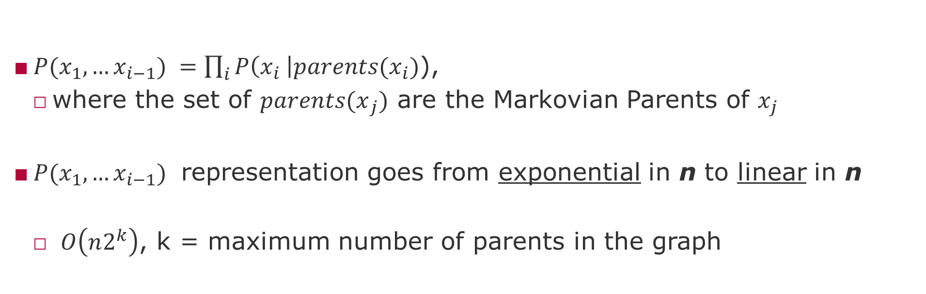
Markovian parents?
$P(x_{1},…x_{i−1}) =\prod_{i}{P\left(x_{i} \right|{parents(x}_{i})}$),
where the set of ${parents(x}_{j})$ are the Markovian Parents of $x_{j}$
$P(x_{1},…x_{i−1})$ representation goes from exponential in n to linear in n
$O\left(n2^{k}\right)$, k = maximum number of parents in the graph
Notes:
However, we can save space if we know that variables depend on a small set of other variables. Dependency structure allows to decompose large distribution functions into smaller ones that can latter on be combined. A dependency structure is a graph.

Slide 7
Methodological problem-II
Besides being small-world representations, a graph allows for the discover of structural properties of the probability models.
However, the graph of these dependencies still grows very fast
7 nodes = 4 million graphs
8 nodes = 800 billion graphs
9 nodes = 1,548 times more
(or 1.2 10^16 graphs)
Hence, we need to be able to refine a graph model.
But how?
source: [Sloane 2019]
Notes:
Hence, we need to be able to refine a graph model, for that we need a set of operations and properties so we can test hypotheses about graph dependencies and independencies
[Sloane 2019] N. J. A. Sloane, Number of acyclic digraphs (or DAGs) with n labeled nodes, in The Online Encyclopedia of Integer Sequences, available at http://oeis.org/A003024/b003024.txt (accessed May 2019)
However, nodes can be arranged in many different. Three nodes can be arranged in 25 different acyclic graphs (DAG), 4 nodes can compose 543, and 5 nodes 29281 DAGs, 6 nodes 3781503, and 7 to 1138779265 DAG. Yes, but how to know which is the correct mechanism?
7 nodes = 4 million graphs
8 nodes = 800 billion graphs
9 nodes = 1,548 times more (or 1.2 10^16 graphs)

Slide 8
Traditional versus Deep Generative Graph Models
Traditional Generative Methods
Rely on structural assumptions: Degree Distributions, Motifs, etc.
Advantages:
Fast
Simple elegant mathematical properties
Disadvantages:
Restricted to structural assumptions
Makes it difficult to generate structures like Grids
Deep Generative Methods
Rely on sampled network context information: Breath First Search, Random Walks, Adjacency Matrix, etc.
Advantages:
Minimum structural assumptions
Generates larger graph
Disadvantages
High architectural complexity
Can be slow

Slide 9
Brief History
Traditional Generative Methods
Erdos, P., & Renyi, A., (1959), On random graphs. Publicationes Mathematicae (Debrecen), 6:290–297
Albert, R., & Barabasi, L., (2002), Statistical mechanics of complex networks. Reviews of Modern Physics, 74(1):47
Robins, G., et al., (2007), An introduction to exponential random graph (p*) models for social networks. Social Networks, 29(2):173–191
Leskovec, J., et al., (2010), Kronecker graphs: An approach to modeling networks. JMRL
Deep Generative Methods
You, et. al, (2018), GraphRNN: Generating Realistic Graphs with Deep Auto-regressive Models, ICML
Li, Y., et al., (2018), Multi-objective de novo drug design with conditional graph generative model. Journal of cheminformatics 10.1: 33.
Zhou, D., et al., (2020), A data-driven graph generative model for temporal interaction networks, KDD.
Notes:
Zhou, Dawei, et al. "A data-driven graph generative model for temporal interaction networks." Proceedings of the 26th ACM SIGKDD International Conference on Knowledge Discovery & Data Mining. 2020.

Slide 10


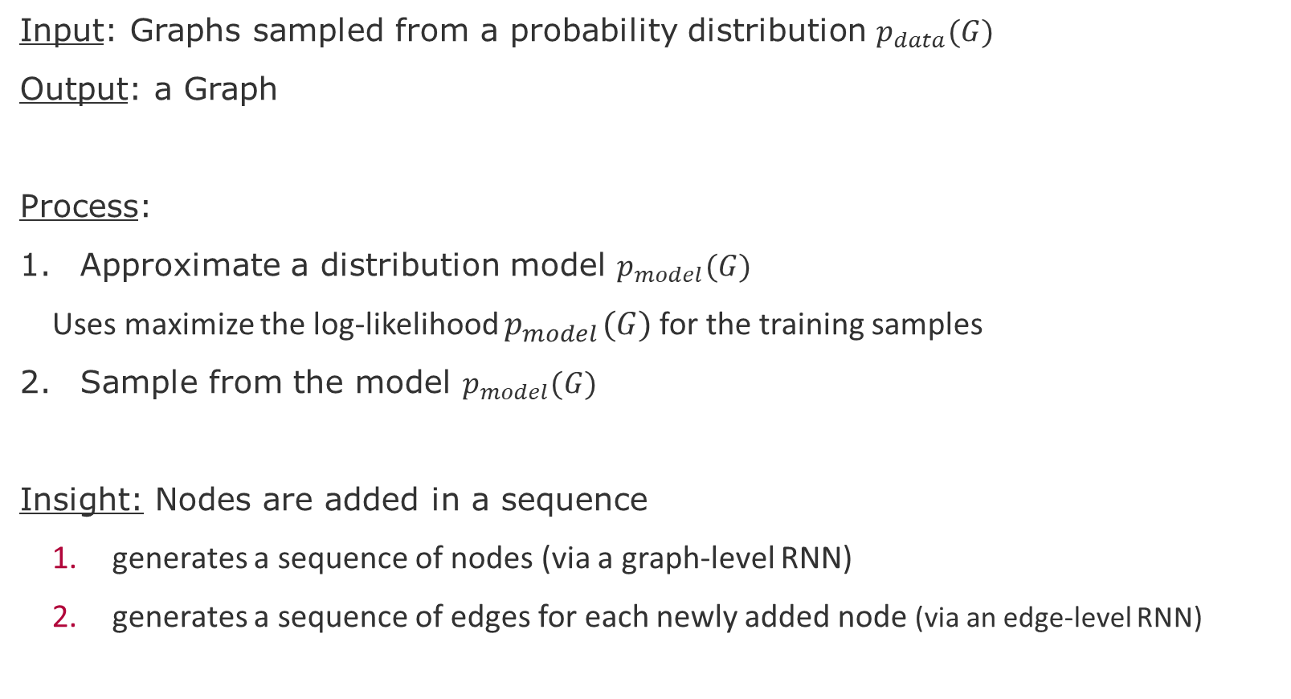
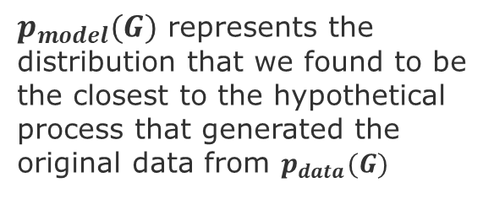
Graph RNN [You et al. 2018]
Input: Graphs sampled from a probability distribution $p_{data}(G)$
Output: a Graph
Process:
Approximate a distribution model $p_{model}(G)$
Uses maximize the log-likelihood $p_{model} (G)$for the training samples
Sample from the model $p_{model}(G)$
Insight: Nodes are added in a sequence
generates a sequence of nodes (via a graph-level RNN)
generates a sequence of edges for each newly added node (via an edge-level RNN)
$p_{data}(G)$ represents some observational data sampled from some natural process
$p_{model}(G)$ represents the distribution that we found to be the closest to the hypothetical process that generated the original data from $p_{data}(G)$
[You et al. 2018] You et. al, (2018), GraphRNN: Generating Realistic Graphs with Deep Auto-regressive Models, ICML

Slide 11
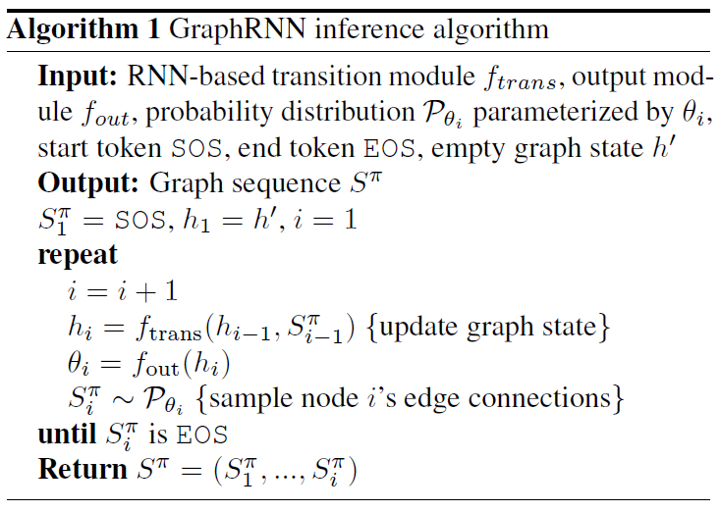


GraphRNN Algorithm [You et al. 2018]
Instead of learning $p(G)$ is learns the $p(S_{ }^{π} )$
$S_{i}^{π}$ is an adjacency vector representing the edges between two nodes that already in the graph
[You et al. 2018] You et. al, (2018), GraphRNN: Generating Realistic Graphs with Deep Auto-regressive Models, ICML

Slide 12
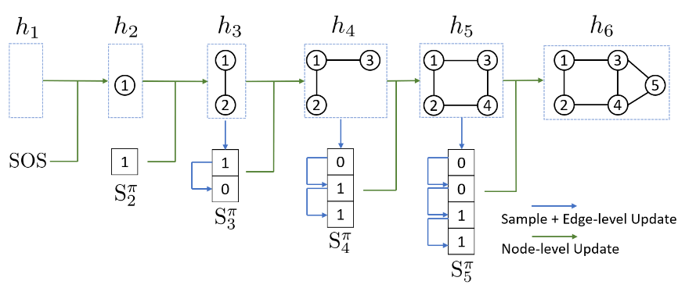
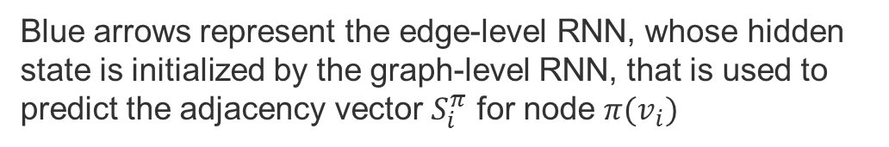
GraphRNN architecture [You et al. 2018]
Green arrows graph-level RNN that encodes the “graph state” vector $h$ hidden states, updated by the predicted adjacency vector $S_{i}^{π}$ for node $π(v_{i})$
Blue arrows represent the edge-level RNN, whose hidden state is initialized by the graph-level RNN, that is used to predict the adjacency vector $S_{i}^{π}$ for node $π(v_{i})$
[You et al. 2018] You et. al, (2018), GraphRNN: Generating Realistic Graphs with Deep Auto-regressive Models, ICML
Source code: https://github.com/snap-stanford/GraphRNN
Notes:
[You et al. 2018] You et. al, (2018), GraphRNN: Generating Realistic Graphs with Deep Auto-regressive Models, ICML

Slide 13
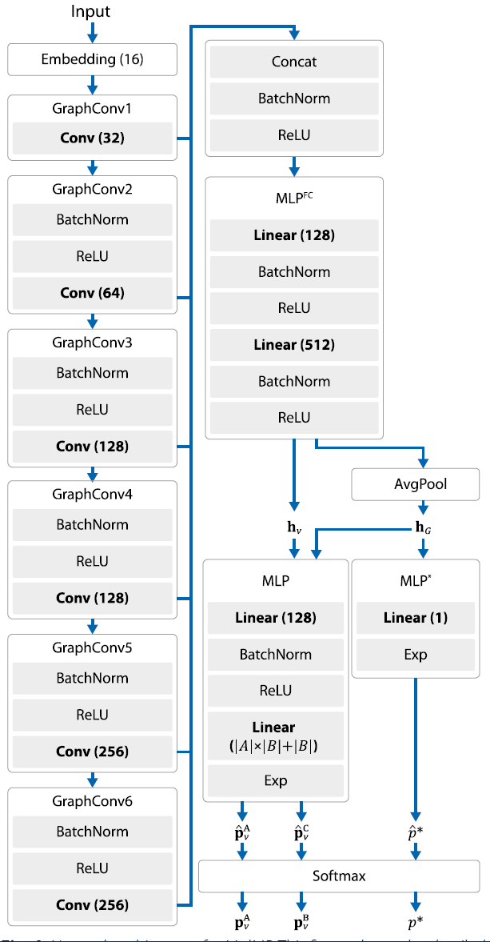
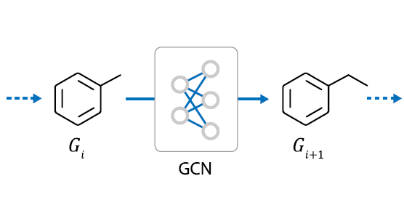
Drug design [Li et al. 2018]
MolMP: this architecture treats graph generation as a Markov process, in which the transition of Gi only depends on the current state of the graph, not on the history
Li, Y., et al., (2018), Multi-objective de novo drug design with conditional graph generative model. Journal of cheminformatics 10.1: 33.
Notes:
Li, Y., et al., (2018), Multi-objective de novo drug design with conditional graph generative model. Journal of cheminformatics 10.1 (2018): 33.

Slide 14
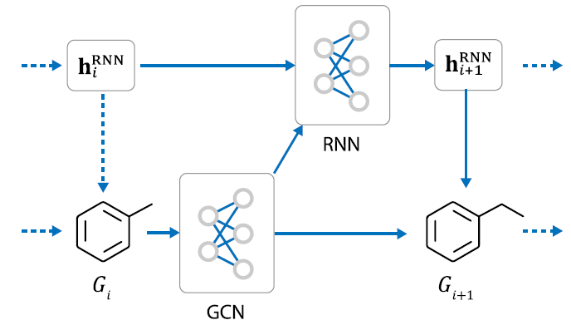
Drug design [Li et al. 2018]
MolMP: this architecture treats graph generation as a Markov process, in which the transition of Gi only depends on the current state of the graph, not on the history
MolRNN: this architecture adds a single
molecule level recurrent unit to MolMP
Li, Y., et al., (2018), Multi-objective de novo drug design with conditional graph generative model. Journal of cheminformatics 10.1: 33.
Notes:
Li, Y., et al., (2018), Multi-objective de novo drug design with conditional graph generative model. Journal of cheminformatics 10.1 (2018): 33.

Slide 15
Generative model for Temporal Graphs TagGen [Zhou et al. 2020]
Input: Raw fine-grain temporal networks (i.e., a collection of time-stamped edges).
Output: Temporal Interaction Network for Anomaly Detection and Link Prediction
Process
Learns the distribution of temporal random walks by using a transformer architecture
Uses local operations add and delete nodes and edges dynamically.
Parameters
the number of timestamps or time slices
time windows sizes to restrict node connections (nodes only connect if the difference between their timestamps is within this range)
Performance: scales linearly with the number of nodes
Zhou, D., et al., (2020) A Data Driven Graph Generative Model for Temporal Interaction Networks
Notes:
end-to-end deep generative model that is able to directly learn from the raw while finest-grained temporal networks (i.e., a collection of time-stamped edges). In particular, our framework is built based on a Transformer machine that learns the distribution of temporal random walks over the input data. To mimic the dynamic systems, TagGen is equipped with a novel context generation scheme that defines a family of local operations to perform addition and deletion over nodes and edges dynamically
[KDD 2020] A Data Driven Graph Generative Model for Temporal Interaction Networks

Slide 16
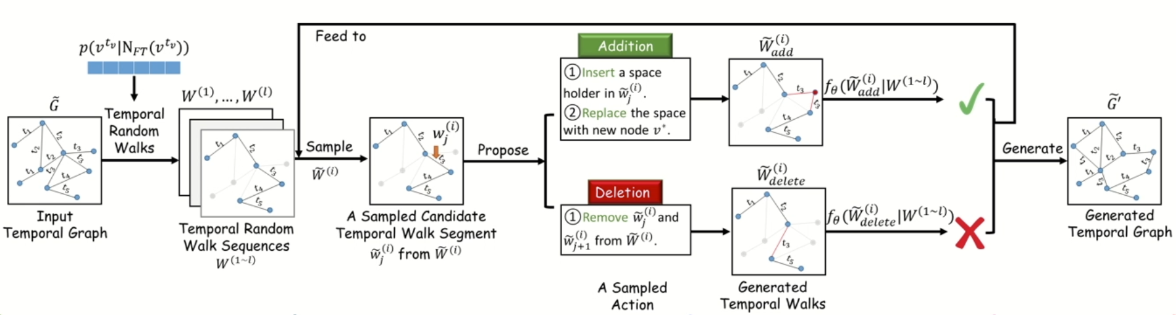
TagGen [Zhou et al. 2020]
Context Sampling
Select nodes based on importance
Random walk
Generation
Mimic a dynamical network evolution
Local operations for adding and deleting temporal nodes
Discrimination
Self-Attention Mechanism
Selects synthetic random walks
Assembling
Aggregate all random walks
Zhou, D., et al., (2020) A Data Driven Graph Generative Model for Temporal Interaction Networks
Source code: https://github.com/davidchouzdw/TagGen
Notes:
A Data-Driven Graph Generative Model for Temporal Interaction Networks
https://dl.acm.org/doi/abs/10.1145/3394486.3403082

Slide 17
Recommended further reading
Li, Yujia, et al. "Learning deep generative models of graphs." arXiv preprint arXiv:1803.03324 (2018).
Van Den Oord, Aaron, and Oriol Vinyals. "Neural discrete representation learning." Advances in Neural Information Processing Systems. 2017.
Ha, David, and Jürgen Schmidhuber. "World models." arXiv preprint arXiv:1803.10122 (2018).
Robine, Jan, Tobias Uelwer, and Stefan Harmeling. "Discrete Latent Space World Models for Reinforcement Learning." arXiv preprint arXiv:2010.05767 (2020).
Lassance, Carlos. "Graphs for deep learning representations." arXiv preprint arXiv:2012.07439 (2020).

Slide 18
Next and Future Tasks
Compute and compare graph metrics (Wednesday, 2.12)
First draft of abstract (Friday, 4.12)
Predictions using traditional method (Wednesday, 9.12)
Related work draft (Friday, 11.12)
Node and Graph Feature Learning (Wednesday, 16.12)
Design alternative pipelines for your GNN
Three alternatives with different options for embedding, aggregation, and encoding
Test at least one.
Execute pipeline for different configurations (will be scheduled individually)
Sensitivity Analysis
Ablation study

Slide 19
END

